Slide 1

IDS 301: The Second Half

Slide 2
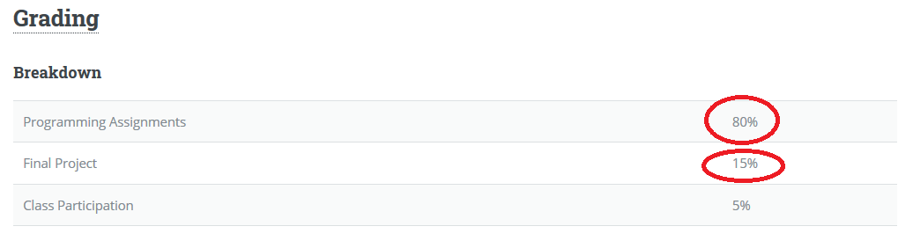
Changes in Grading

Slide 3
Remote Working Survey: Student Concerns
Being able to attend / keep up (lack of internet, home life, extra responsibilities, etc)
Lack of helproom / office hours / support with assignments
Maintaining buddies / groupwork / community

Slide 4
Concern #1: Attendance / Internet / Home Life / Etc
5-10 Minute Module Before Each Class (video and writeup)
Microsoft Teams meeting during regular class times to ask questions / work through examples together
If you can’t make it to our class time virtual session, tell me beforehand, and I won’t count it towards grade
Will try to have text transcripts for people who can’t watch the videos later

Slide 5
Concern #2: Office Hours / Helproom
I will be on voice chat during all office hours, and possibly more
I will be even more accessible than usual over personal chat on Microsoft Teams
We will work to rope in helproom T.A.s in Teams

Slide 6
Concern #3: Maintaining Buddies/Community
Group chat with buddies over teams, share code, add me to group

Slide 7
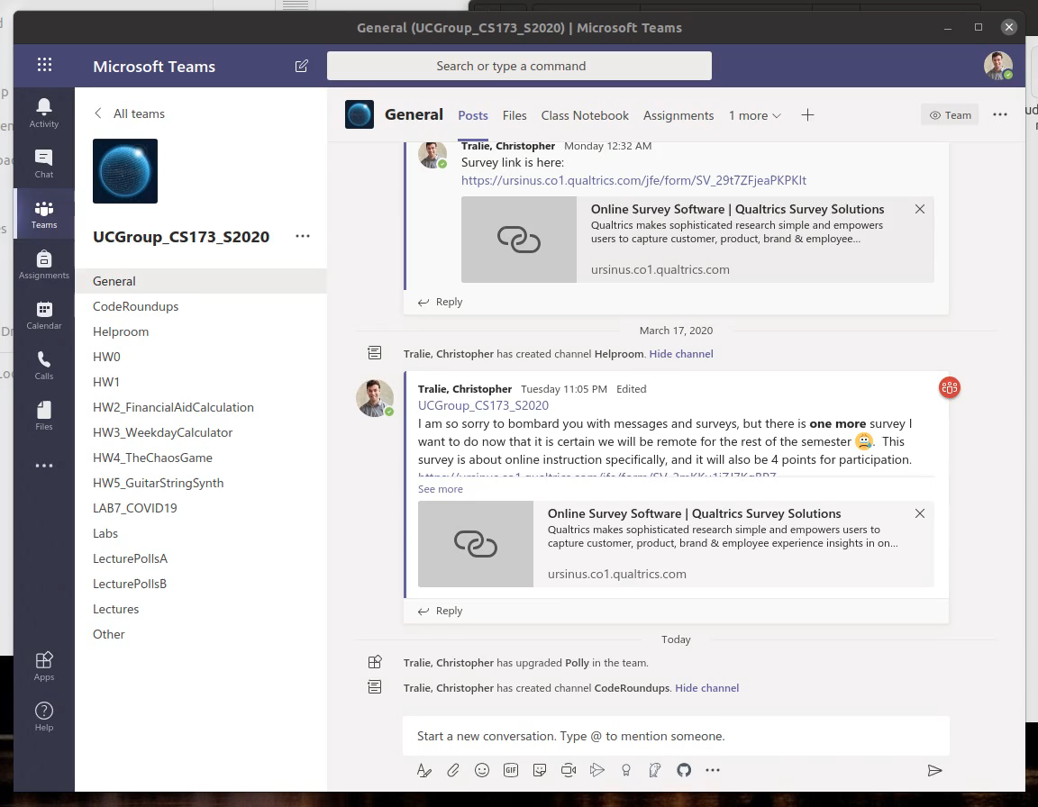
Pasting Code

Slide 8
Final Notes
My philosophy: Keep up the growth and challenge that we’ve had so far to the extent possible
Lucky that we’re a CS class
Lucky we’re already using Teams
Lucky we’ve had 7 weeks to establish rapport
This will be hard, but we will make it through together
I can be as flexible as possible if you communicate
Notes on mental health during this time of uncertainty
Stay in touch!

